Slide 1



SMART MENSTRUAL WASTE DISPOSER
TEAM NAME :AZTECS
TEAM LEADER :LOKESH SARAVANAN G K
TEAM MEMBERS :MOHAMED ATHEQ A
MALAVIKA V
GUIDE NAME :Dr.N.KASTHURI
1

Slide 2
PROBLEM STATEMENT : “Technological solutions for safe disposal of menstrual waste.” OBJECTIVE : The primary objective of this project is to develop a safe and eco-friendly process for disposing of used menstrual wastes. This process involves the sterilization of the menstrual wastes using heat waves, followed by the controlled incineration of the sterilized menstrual wastes and the condensation of emitted gases into a non-hazardous liquid form..

Slide 3
Solution:
Collection and Sterilization:
Used menstrual pads are collected from sanitary disposal bins. The collected pads undergo a rigorous sterilization process using heat waves, ensuring the elimination of harmful microorganisms.
Incineration with Induction Coil:
Sterilized pads are placed inside a metal container equipped with an induction coil. The pads are gradually heated, leading to controlled incineration. This process minimizes harmful emissions while reducing the menstrual wastes to ash.
Gas Emission Control:
The gases emitted during incineration are directed through a pipe system to a specialized condenser. This condenser cools and converts the gases

Slide 4
collection
sterilization
storing
Burning
Smoke condensation
Wastes are collected (Initial smoke reading is noted)
Sterilization using heat waves
Stored up to the max count (Count taken using sensors)
Burned using E-Induction Temp-Control (Chamber works on Auto ON/OFF mechanism)
The smoke released is condensed pressure is maintained / Ash is converted into useful products

Slide 5

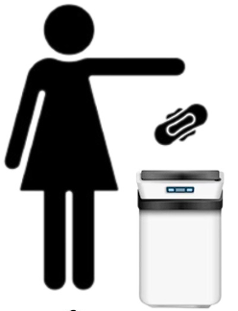
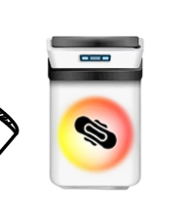
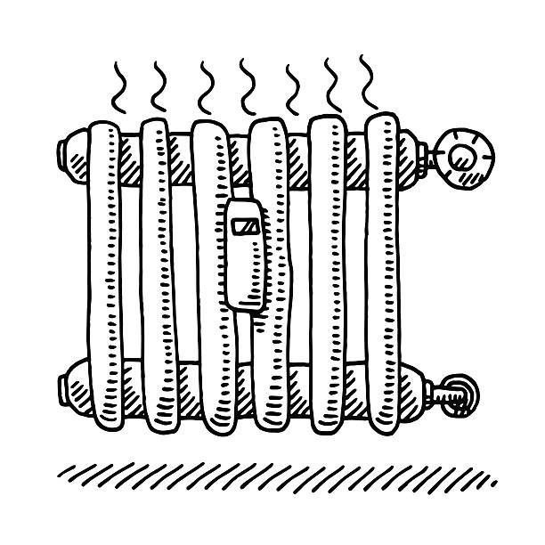

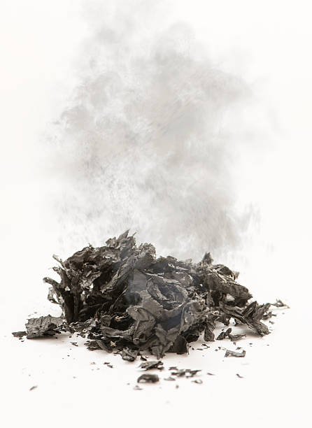
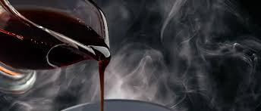


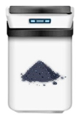
PROCESS
1
2
3
Menstrual waste are dropped in a special chamber or container. Otherwise collected from the households, educational institutions, public places etc.
The count of menstrual waste is taken using sensors.
The menstrual waste is sterilized and dried separately to avoid the smell and germs which is in it. The dried waste are stored chamber.
After storing if it reaches a certain limit the burning chamber automatically functions when it reaches maximum temperature it is auto switched OFF
5
6
4
The result of burning is dry ash and smoke which will be processed in its own ways.
The smoke is not allowed to escape it is condensed and made into fuel which can later be used instead petrochemical
The wastes are burnt by electric induction method.

Slide 6


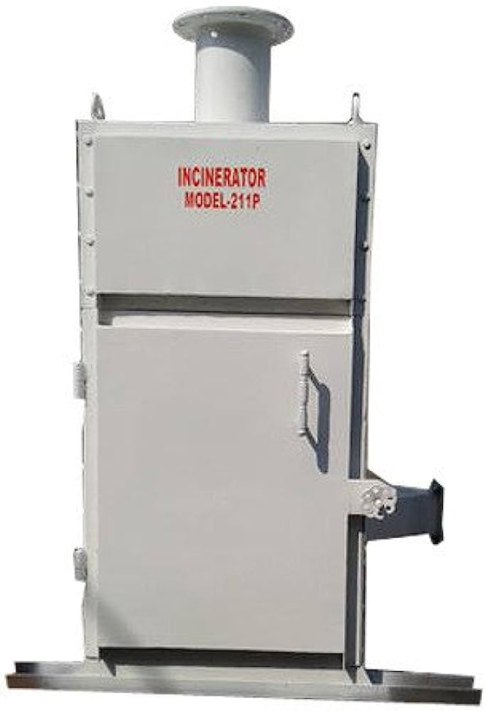




APPLICATIONS:
01
02
➢Schools / College hostels.
Hotel rooms & Lodges.
05
Villages & Streets (Maybe each one machine)
BORCELLE
03
04
Railway/Bus stations & Air ports
Public restrooms & commercial areas

Slide 7
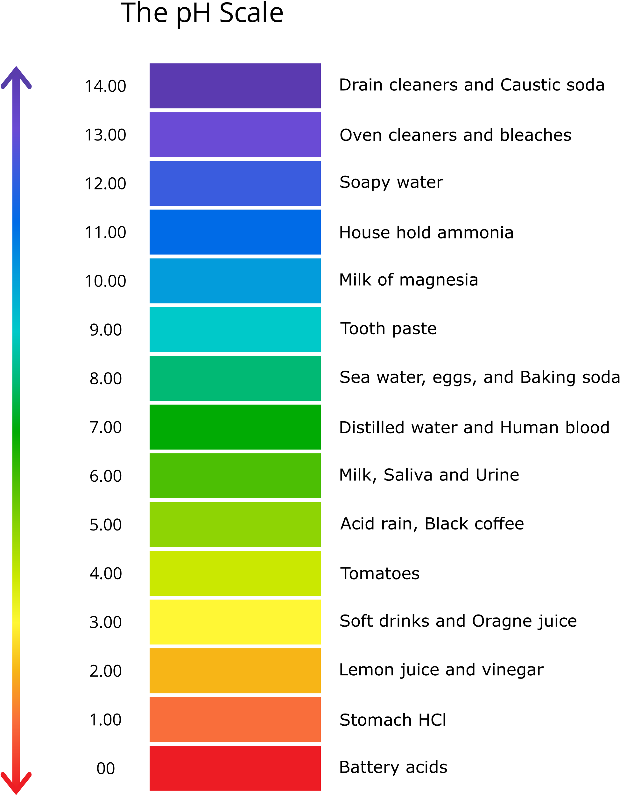
RESULT:
The liquefied smoke is composed of chemical derivatives of alkanes, alkenes, cycloalkanes, cycloalkenes, and alcohols.
The PH value of the liquid measures in the range between 5.9 – 6.1
The ash collected in the ash tray is used as a filler material for pesticides.
Collecting & burning of menstrual waste is carried out. The smoke released contains the following compounds,
Dimethyl phthalate (DMP)
Sulfur dioxide
Carbon dioxide
Carbon monoxide
Toluene
Chloroform
Benzene
Acetone Etc…
The smoke is condensed into liquid.

